Slide 1
Events 2016-17

Slide 2
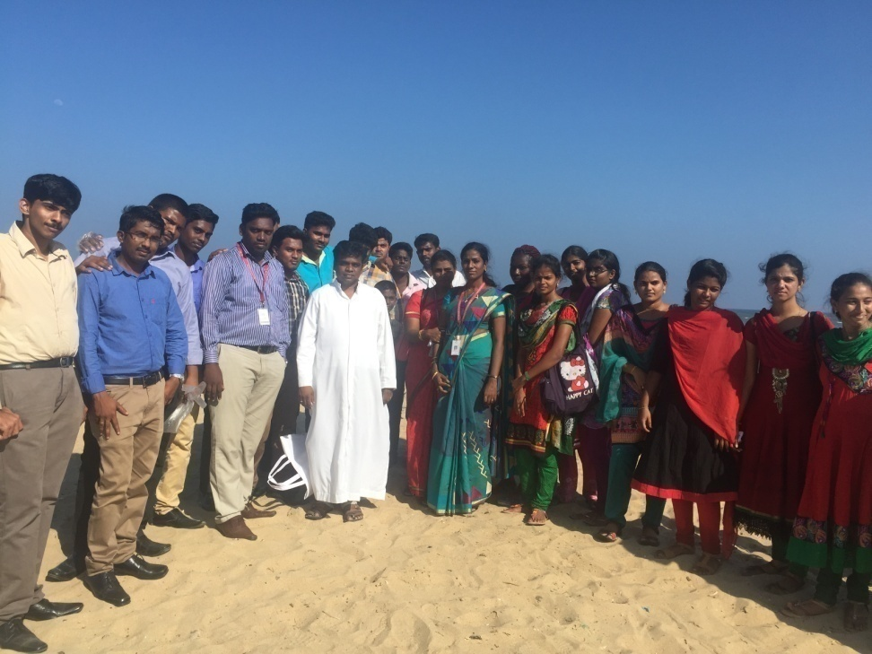
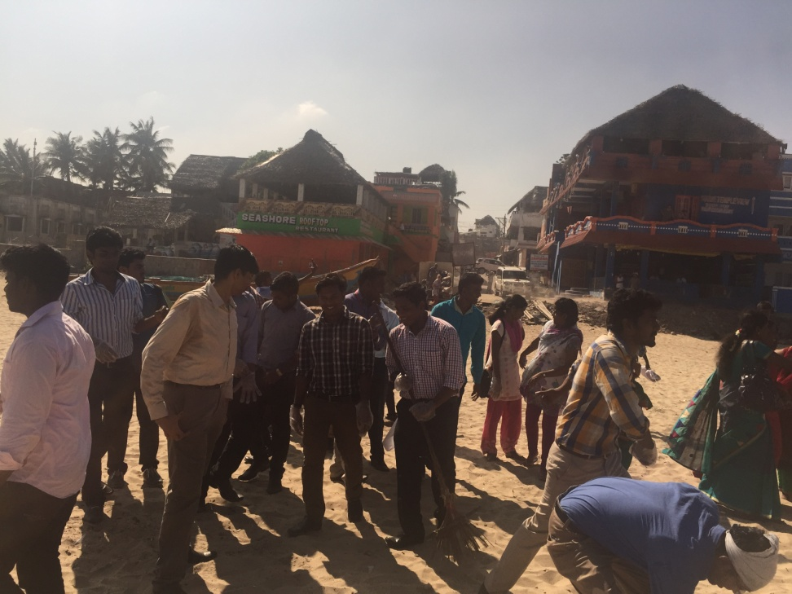
Beach Cleaning – 18.02.16

Slide 3
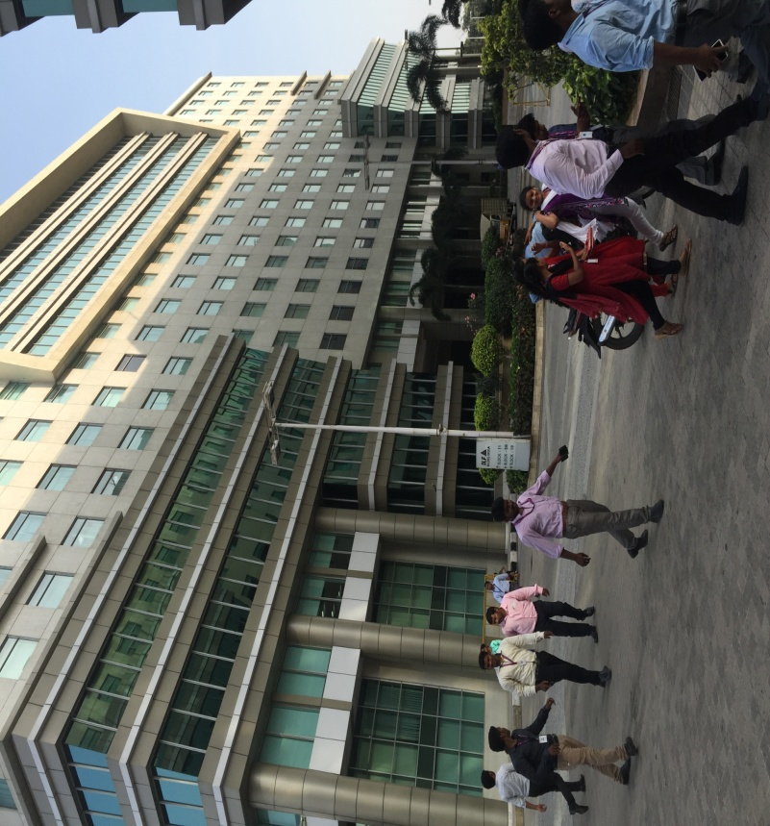
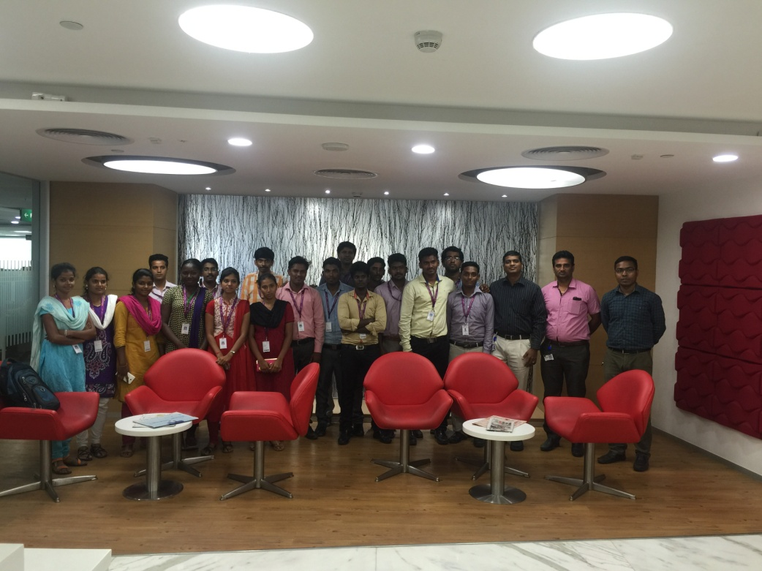
Industrial Visit to Barclays Bank, DLF – 22.03.16

Slide 4
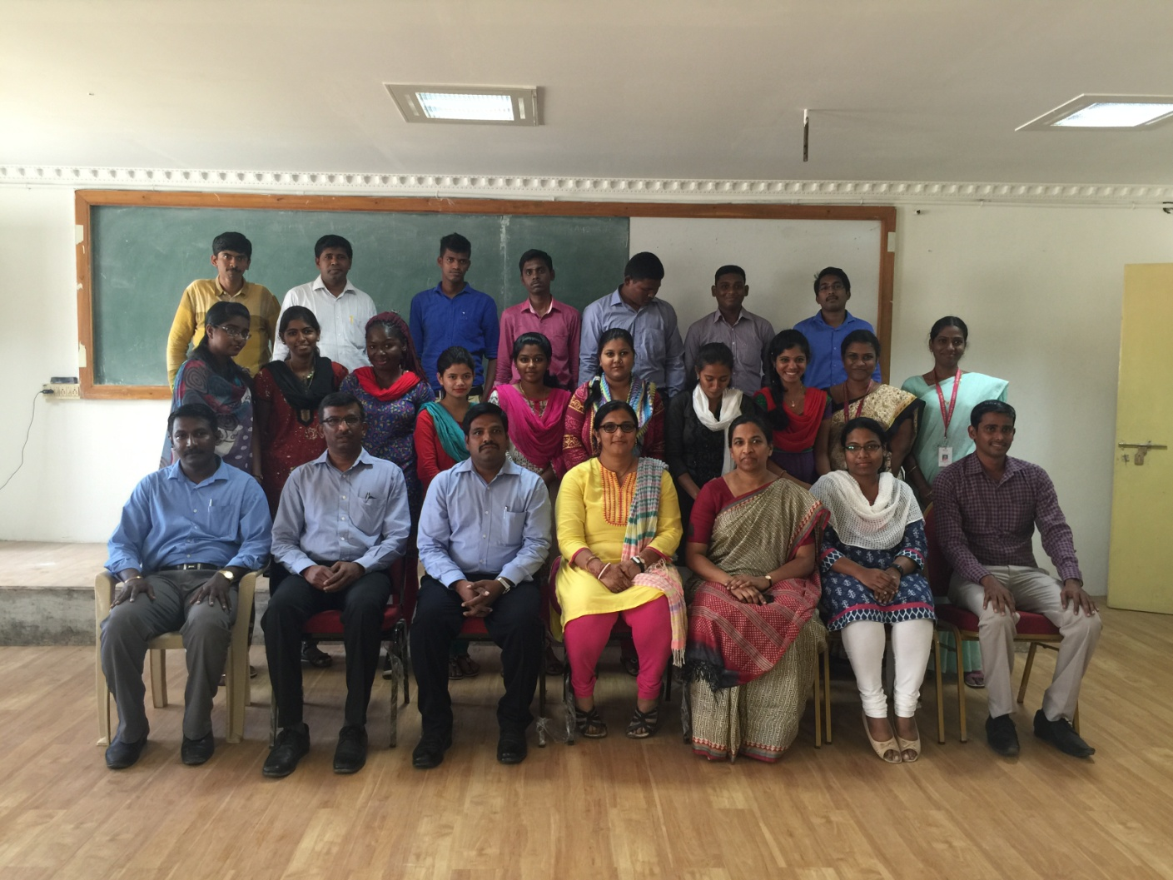
A Guest Lecture on Strategies in Service Marketing by a Team of Experts from McDonald’s – 25.02.16

Slide 5
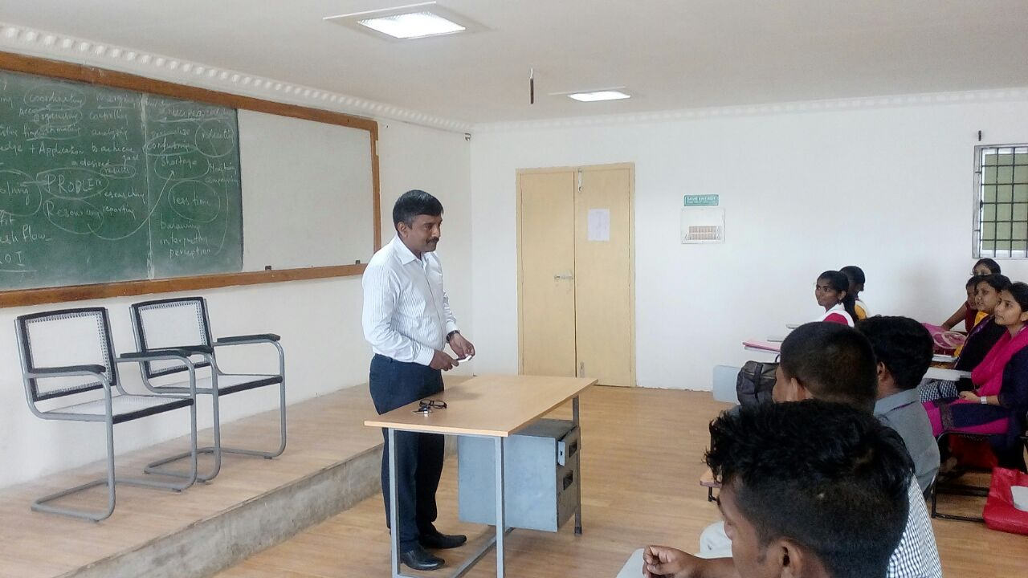
An Orientation on Internship - Opportunities & Challenges by Mr.Sri Kumar, Director – Dr.Smilez Chain of Dental Hospitals and CEO of SkillsGrow on 20.07.16

Slide 6
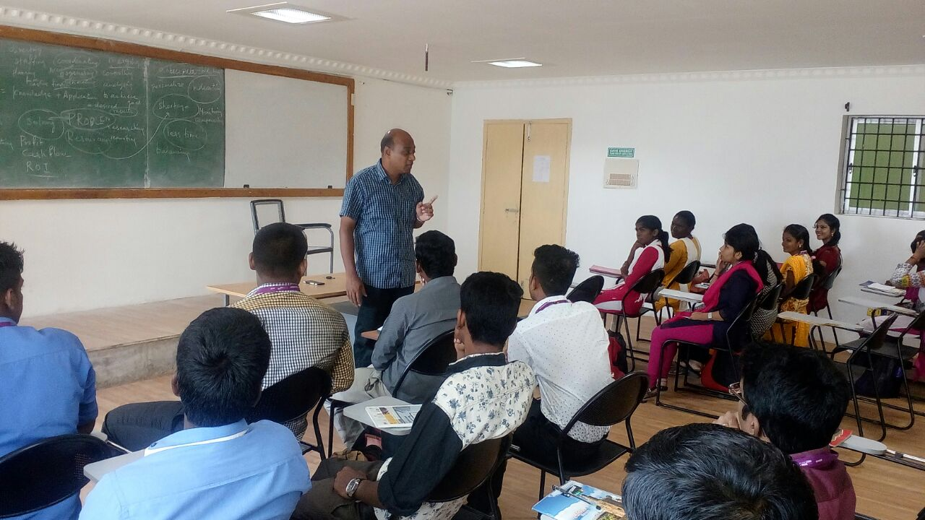
A Guest Lecture on Mapping the Career by Mr.Bhasker, Director – Princeton Group on 20.07.16

Slide 7
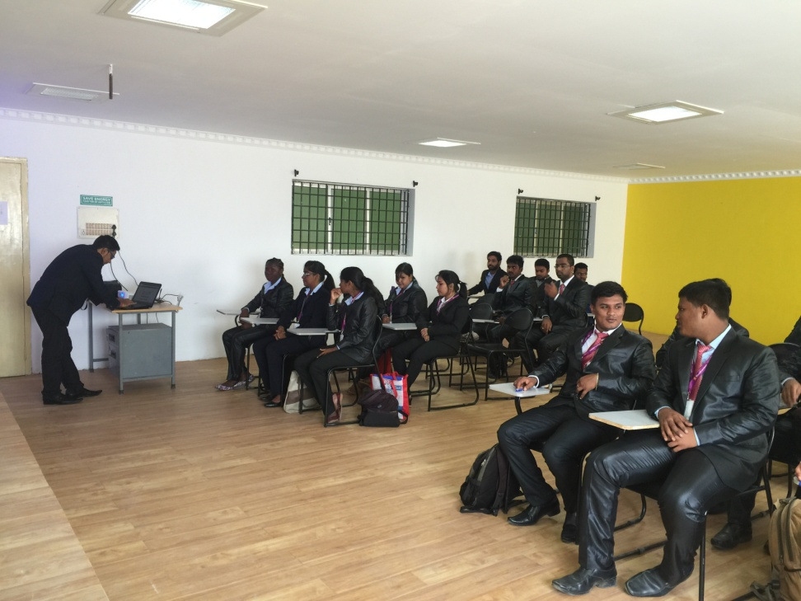
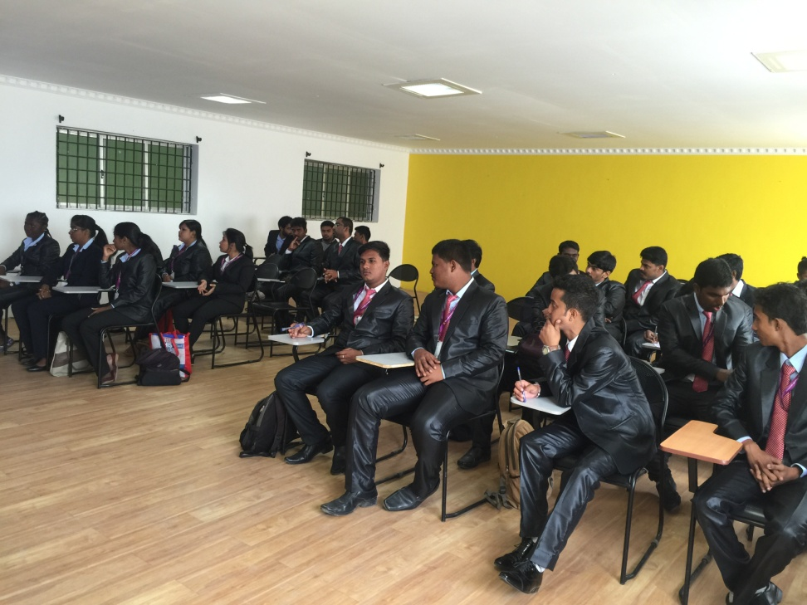
Internship Recruitment Drive by Zenworks, Bangalore on 02.08.17

Slide 8
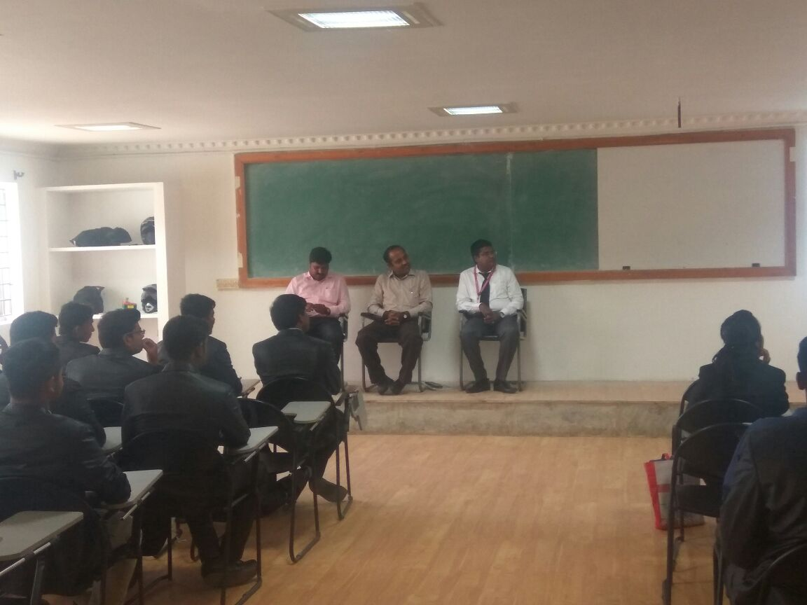
A Guest Lecture on Internet of Things by Mr.Amirthanathan, Delivery Head, Tech Mahindra on 02.08.16

Slide 9
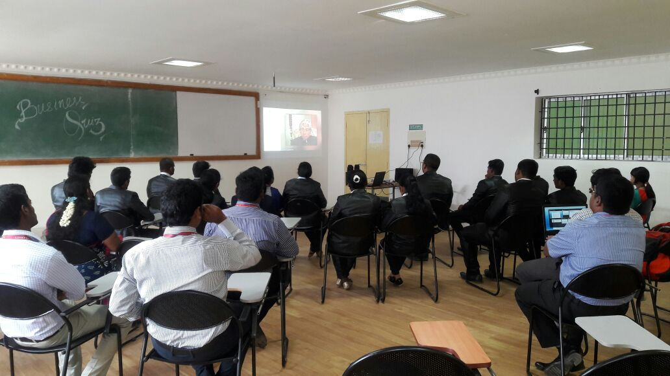
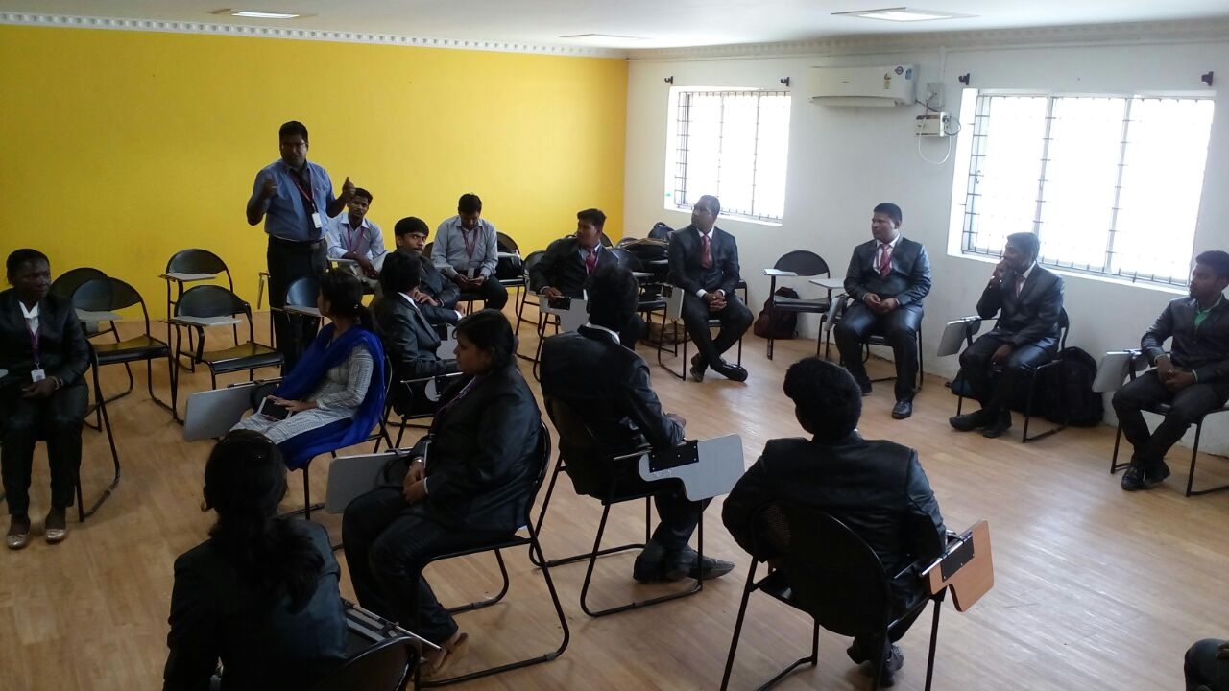
Interdepartmental Competitions to Commemorate the First Anniversary of Dr.APJ Abdul Kalam on 27.07.16

Slide 10
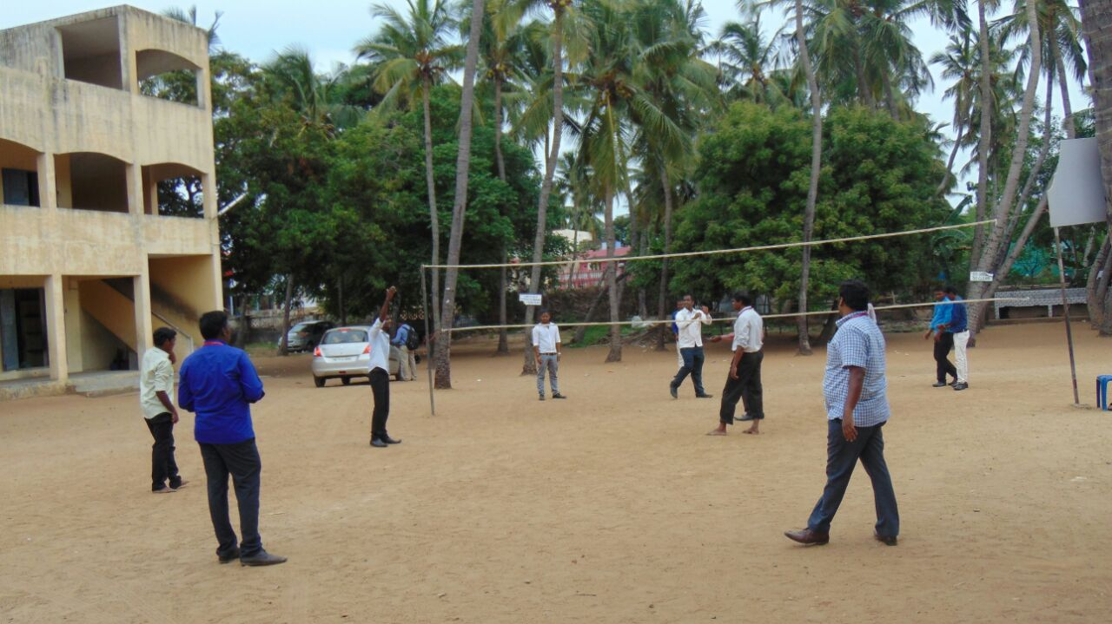
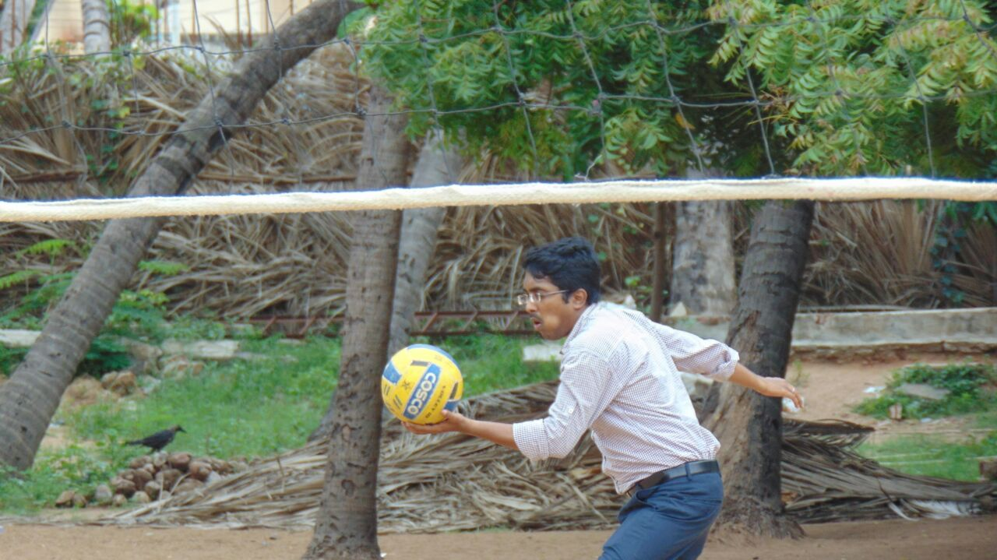
Staff Vs Students : Volley Ball Match 05.08.16

Slide 11
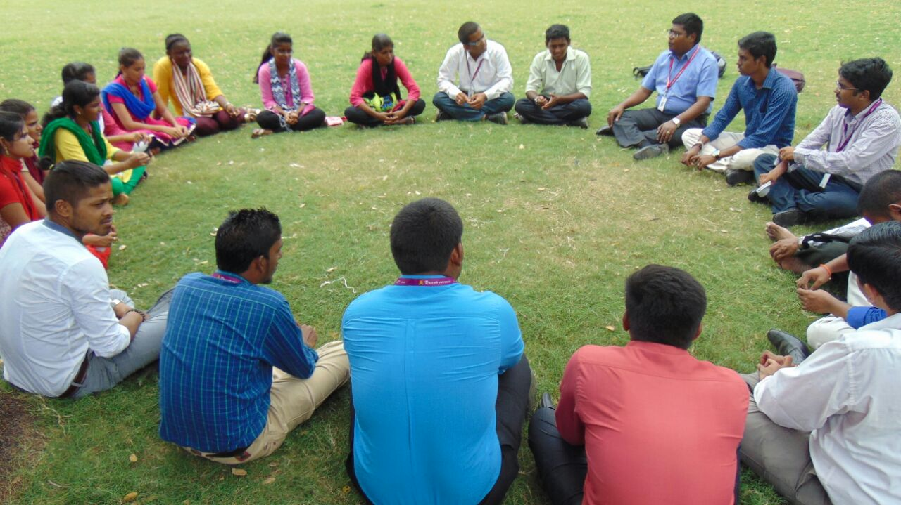
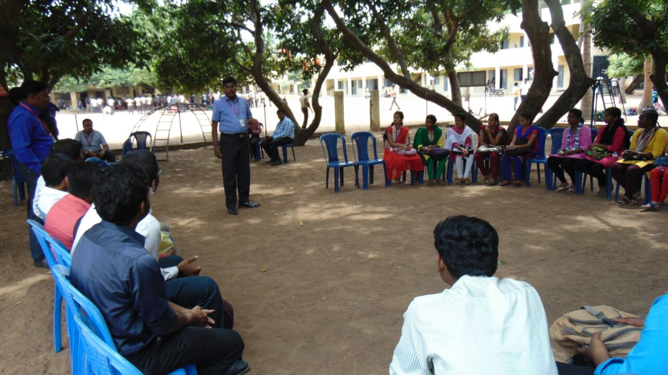
Outbound Case Study Workshop at Mahabalipuram 05.08.16

Slide 12
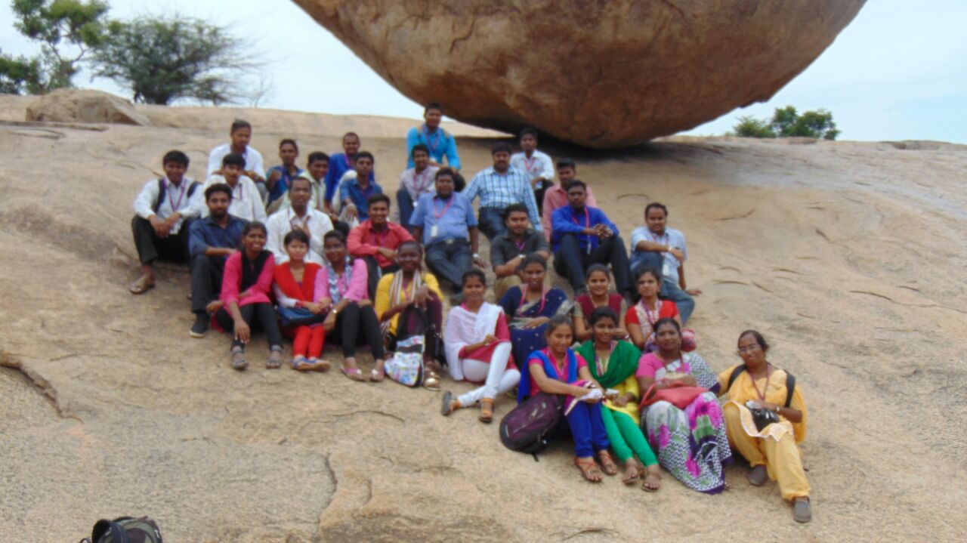
Outbound Case Study Workshop at Mahabalipuram 05.08.16

Slide 13
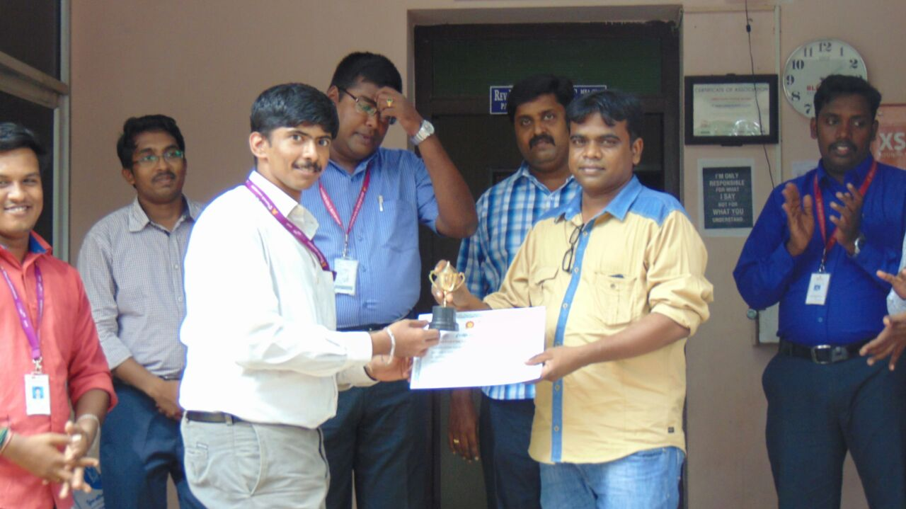
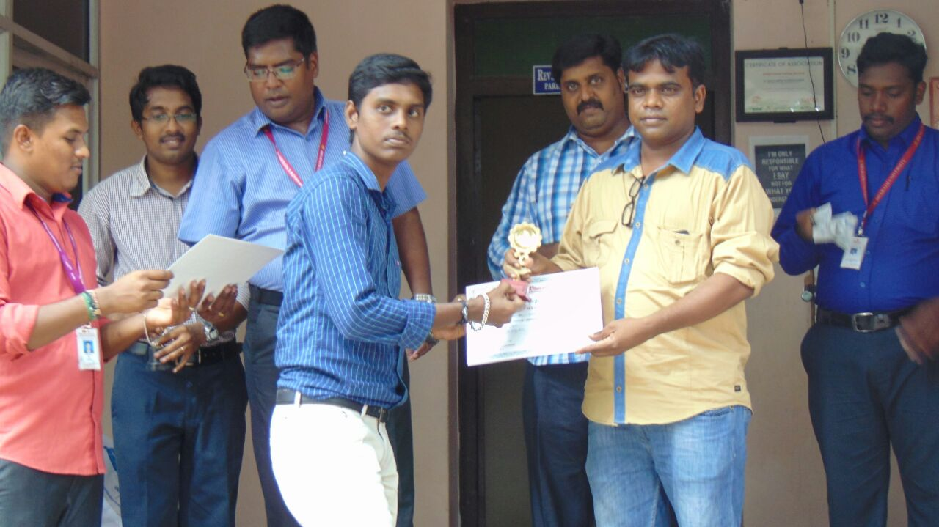
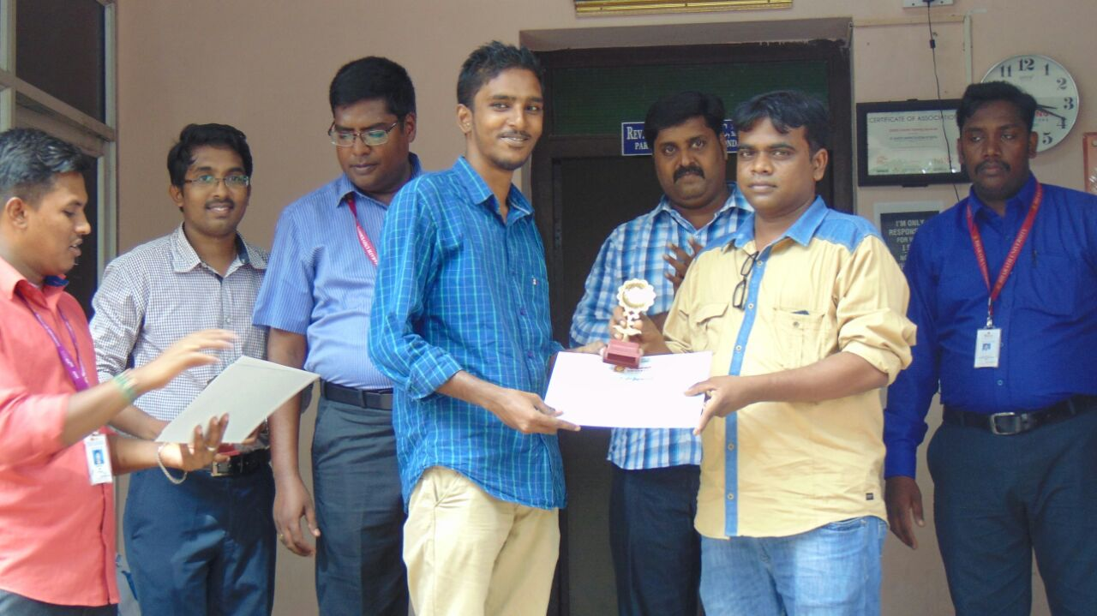
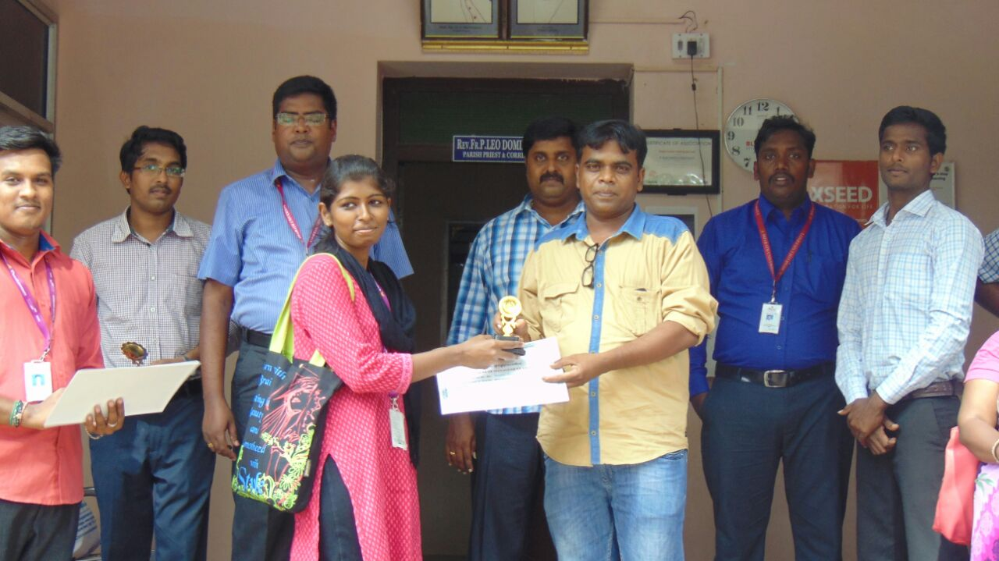
Prize Distribution for Interdepartmental Competitions to Commemorate the First Anniversary of Dr.APJ Abdul Kalam on 27.07.16

Slide 14
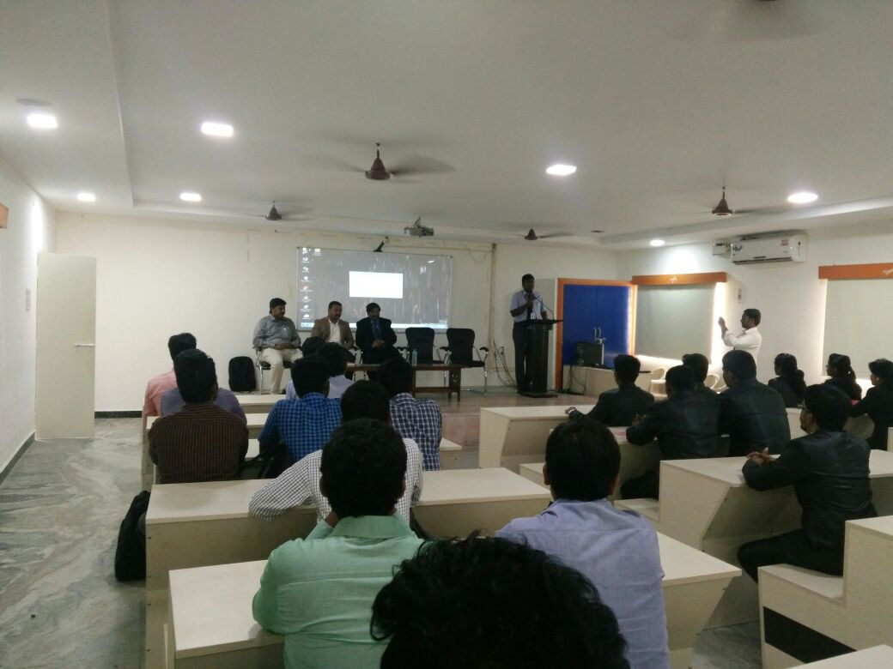
Internship Interview by Klare & Jones on 09.08.16

Slide 15
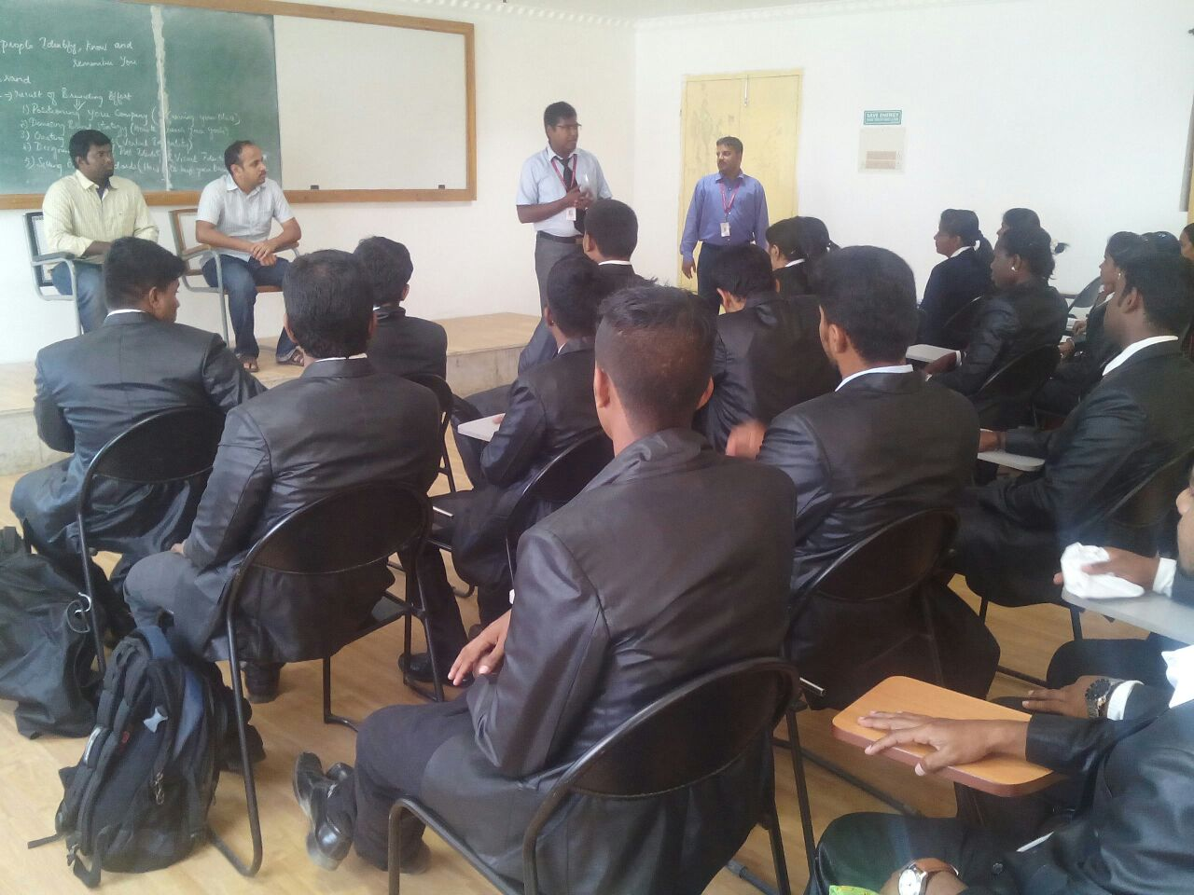
Internship Interview by Jetpat on 09.08.16

Slide 16
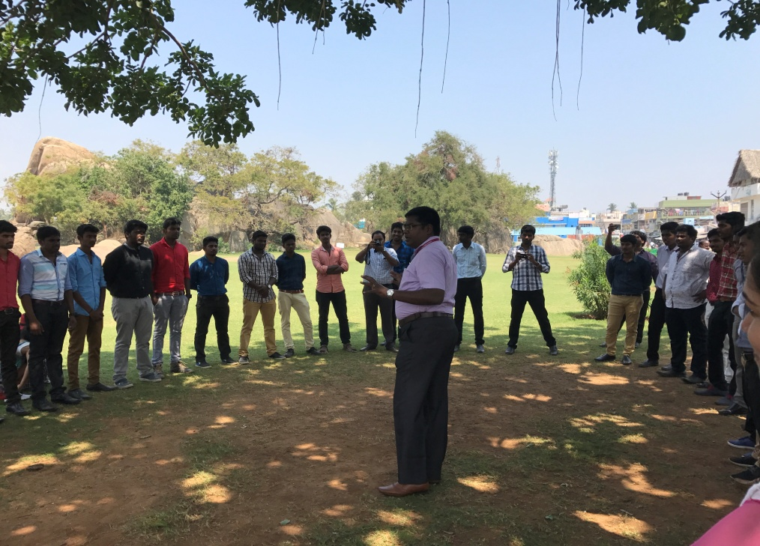
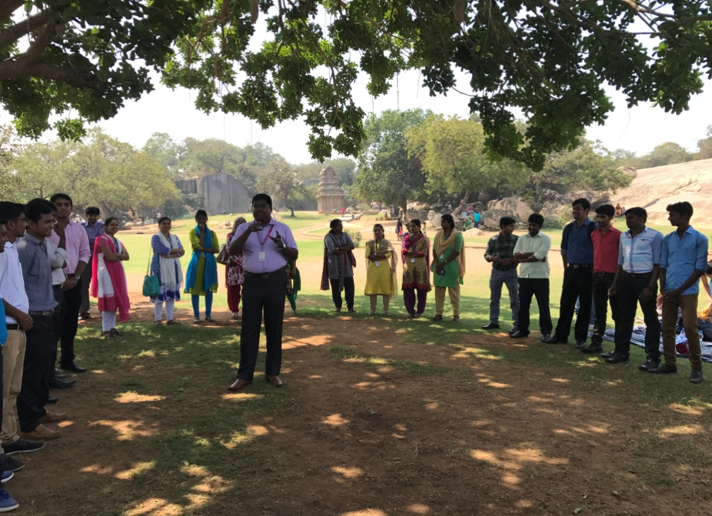
Outbound Case Study Workshop 3.3.17 in Mahabalipuram

Slide 17
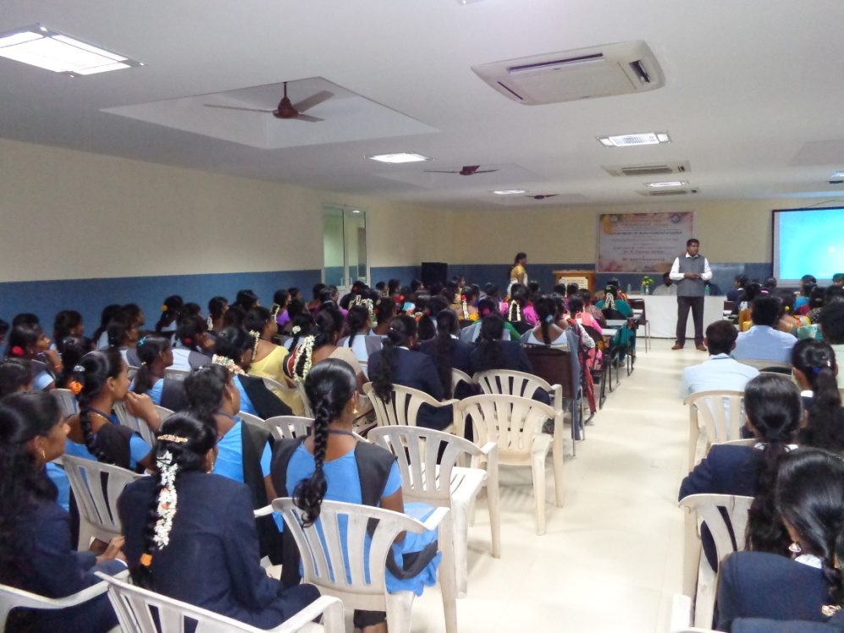
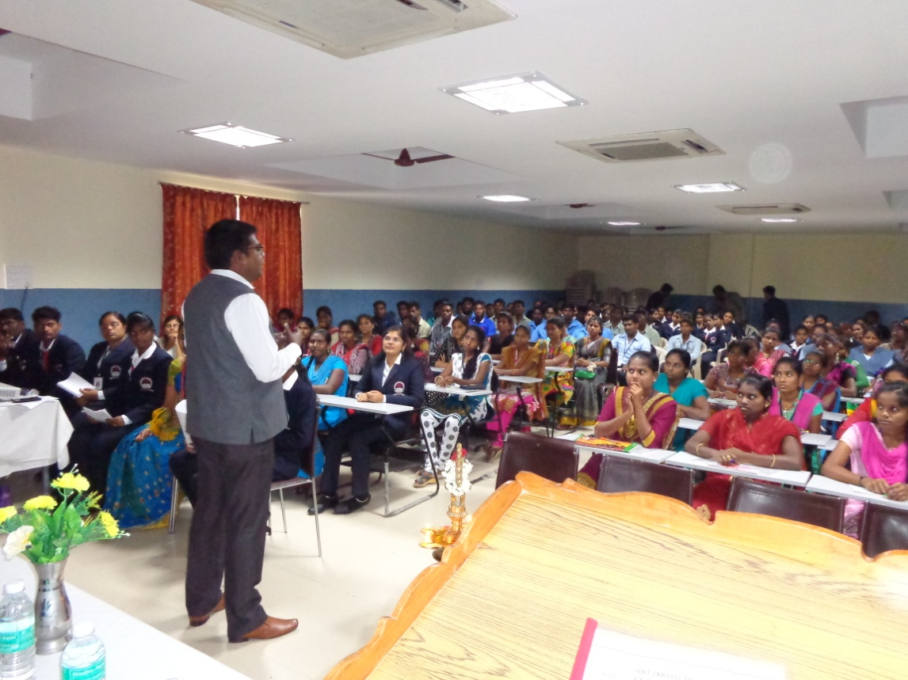
Workshop at GRT Engineering College 21.02.17

Slide 18
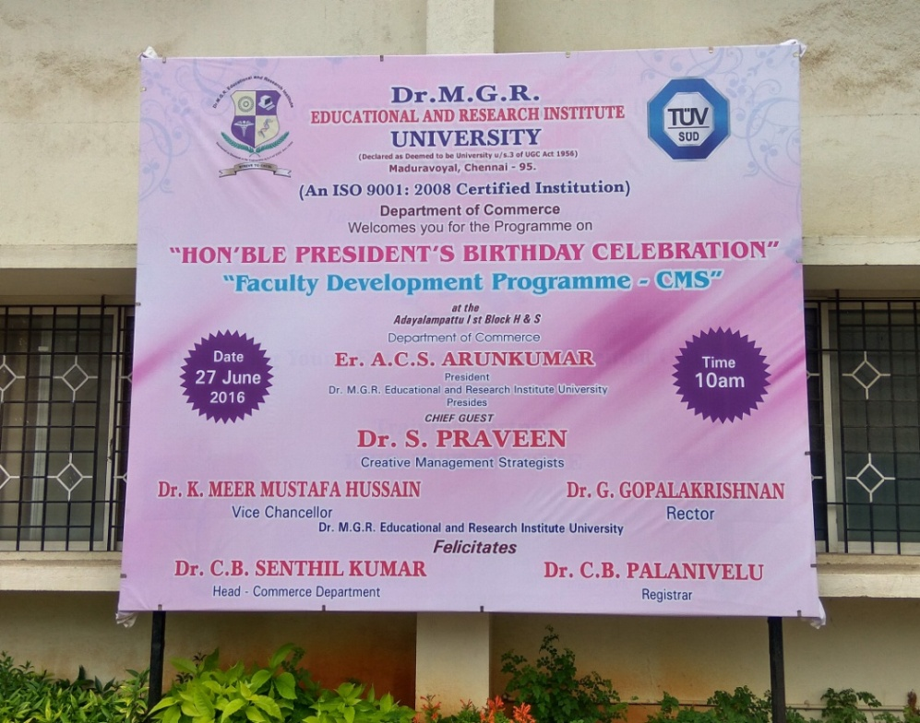
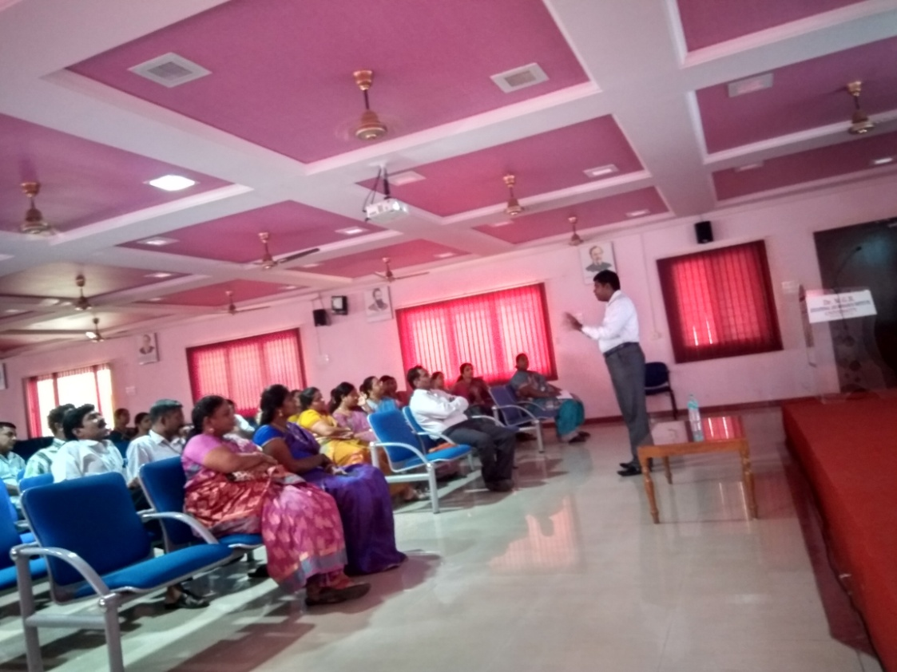
Resource Person at Dr.MGR University, FDP Programme

Slide 19
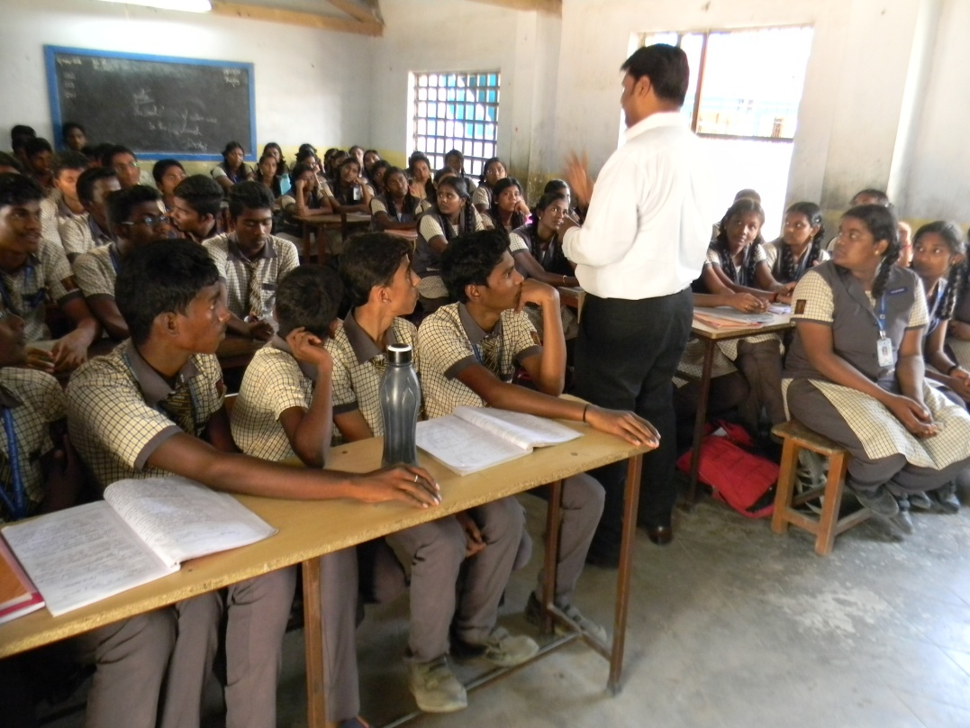
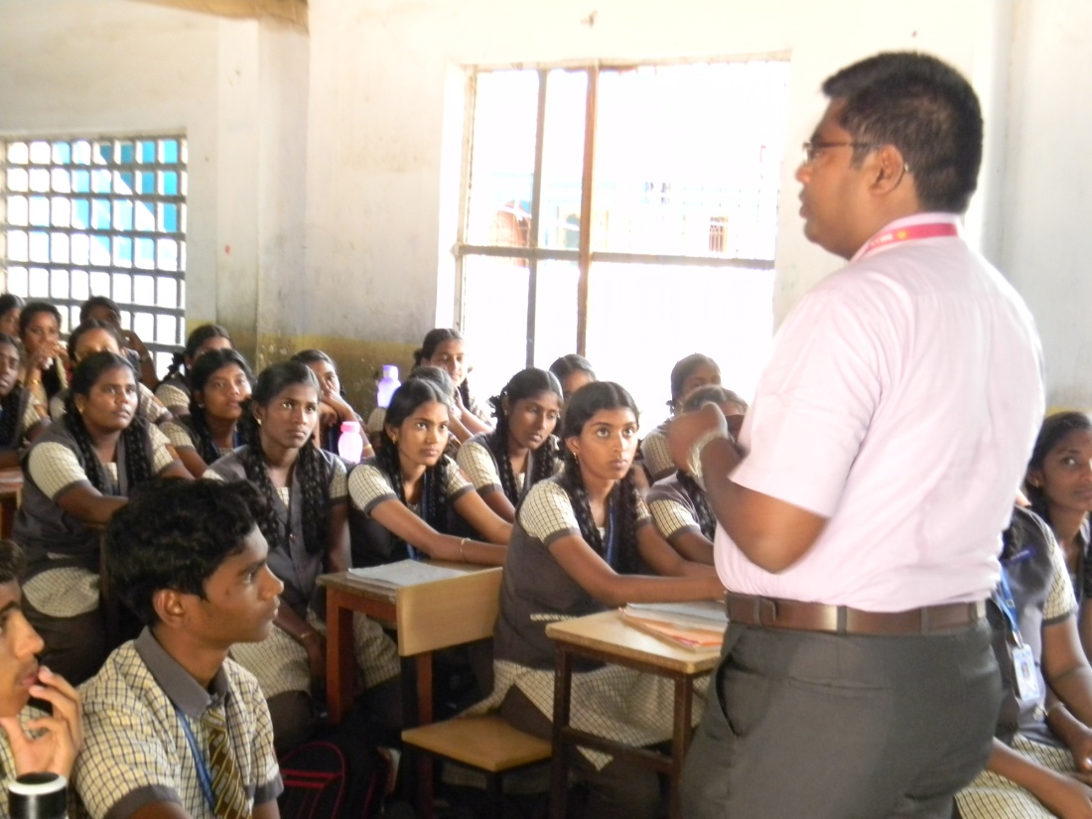
St.Mary’s HSS School, 3.3.17

Slide 20
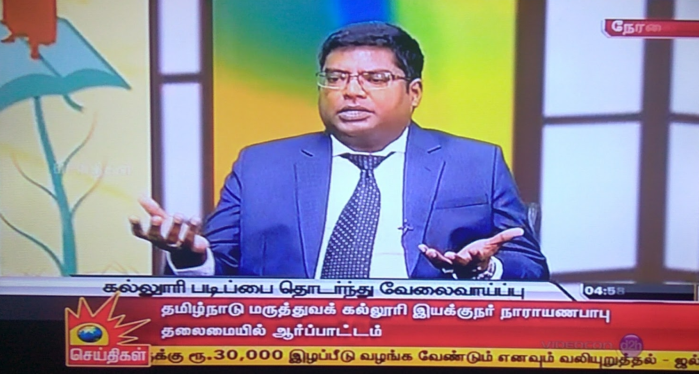
Kalaigner TV – Kalvi Chelvam (Jan 2017)

Slide 21
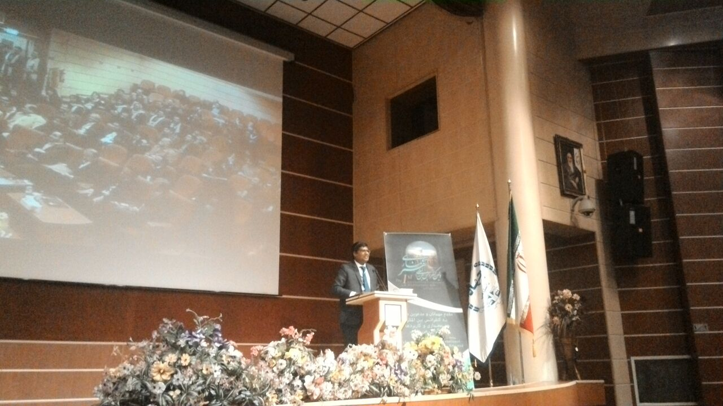
International Conference – Iran (Dec 2016)

Slide 22
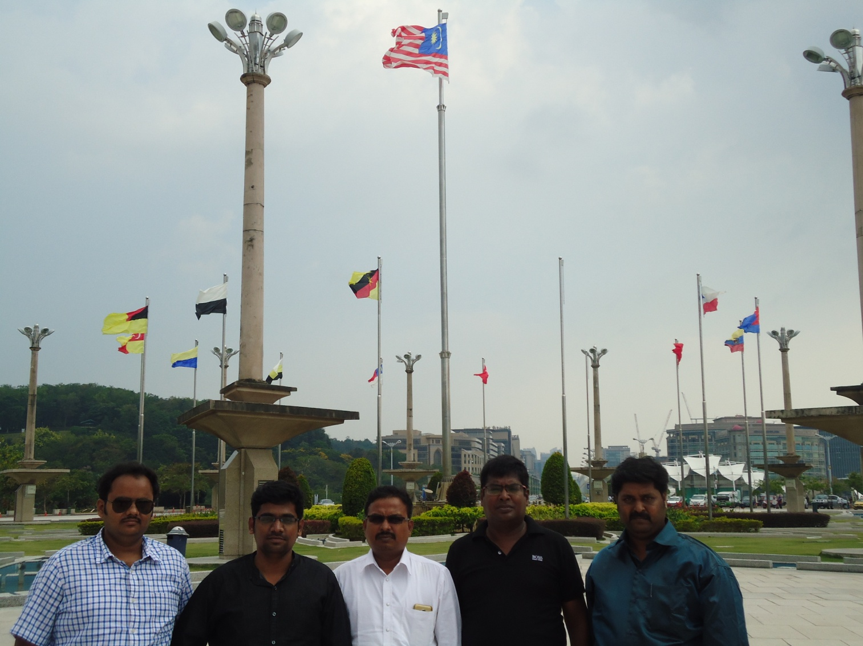
International Conference Malaysia (March 2016)

Slide 23
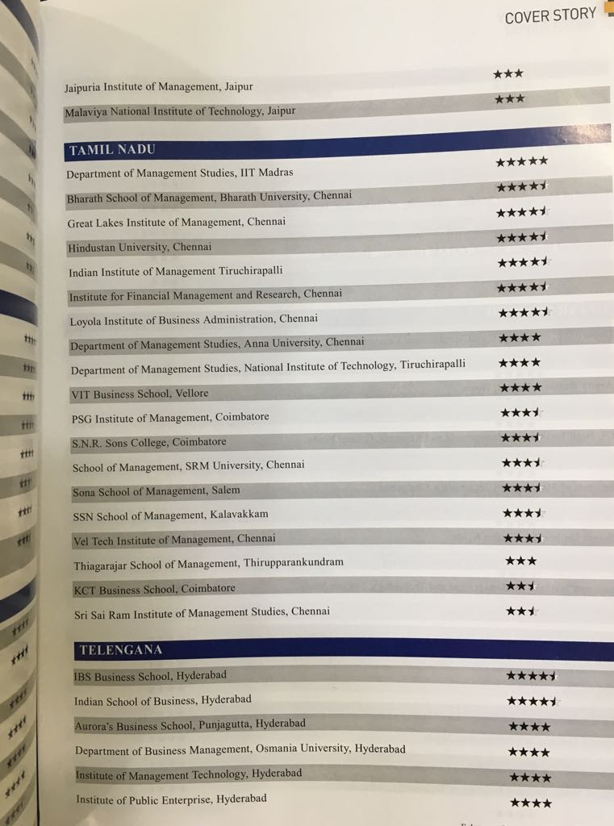
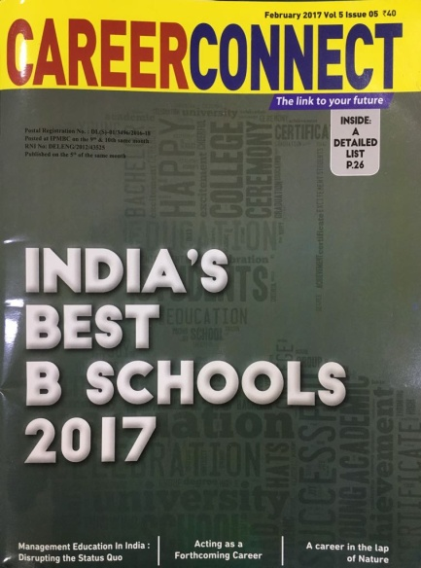
2 ^{nd} Rank in the Career Connect Ranking of Best B School (Feb 2017)

Slide 24

8 ^{th} Rank in the Business Today Ranking of Best B Schools (Dec 2016)

Slide 25
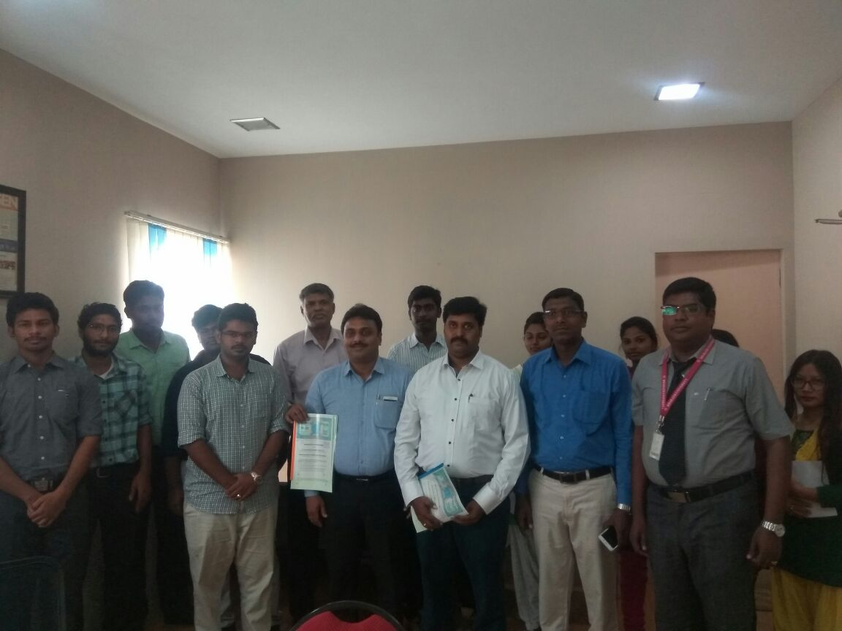
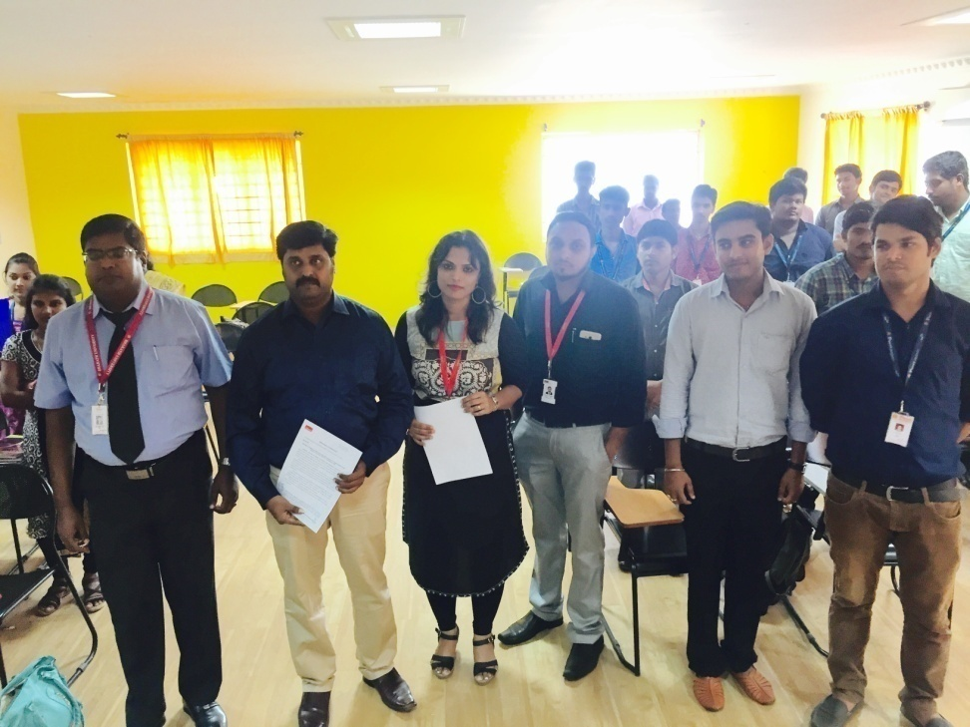
MoU signed with Xaxis and Edufic

Slide 26
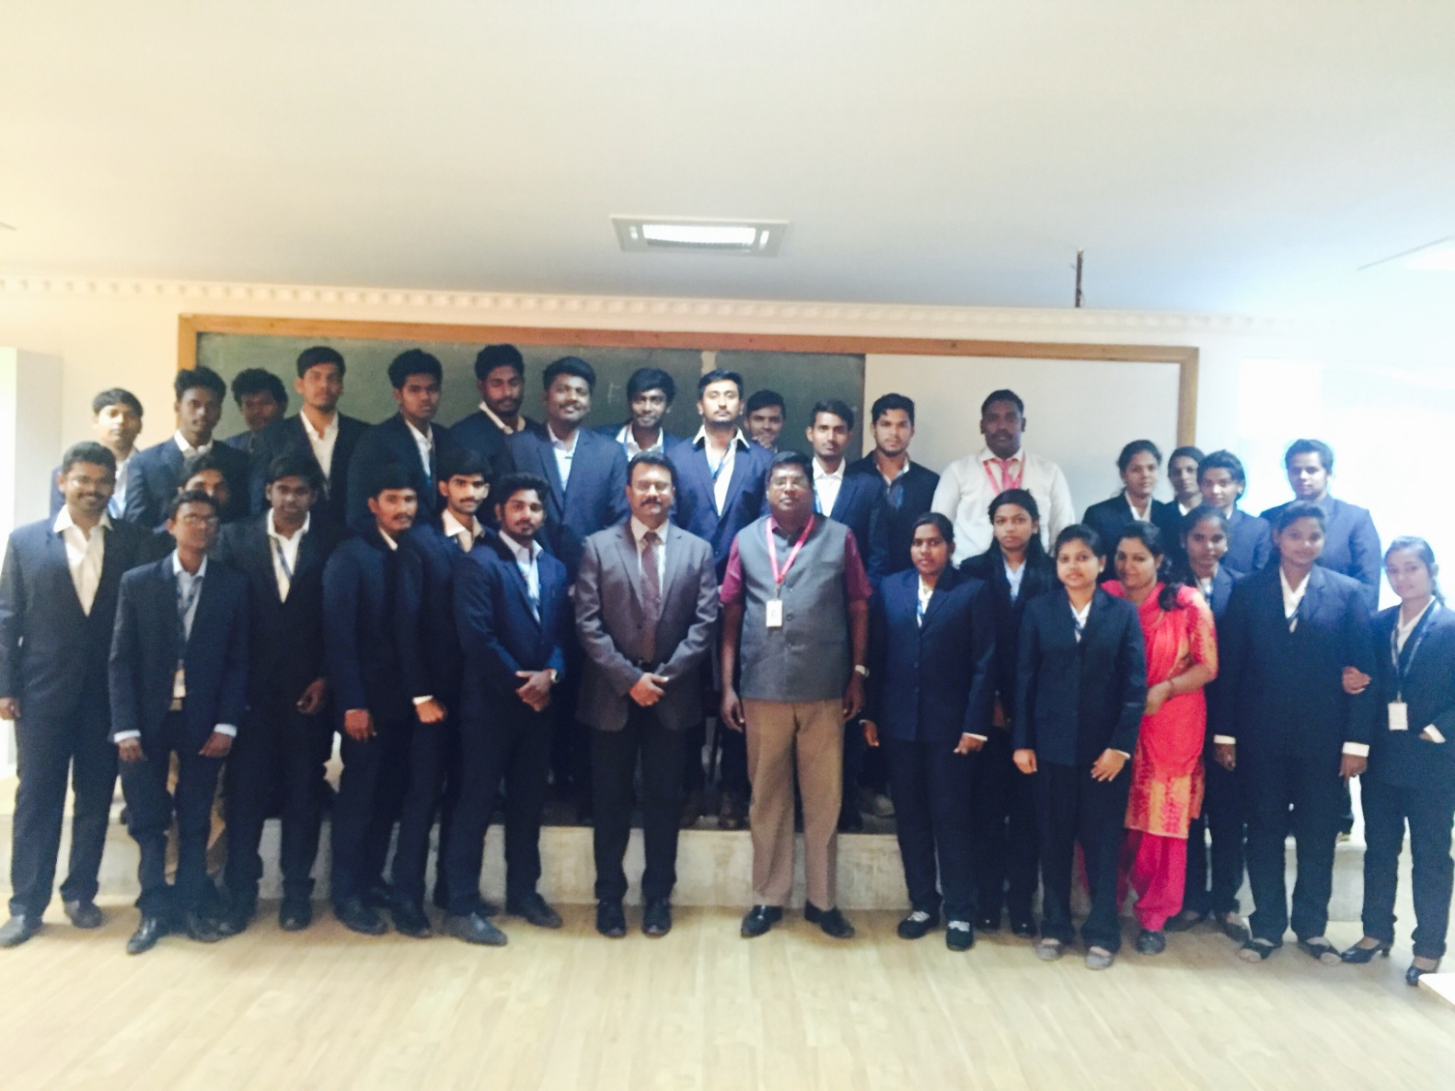
Guest Lecture by Mr.Naren, Professor, Intelek International College, Malayasia – 09.02.17

Slide 27
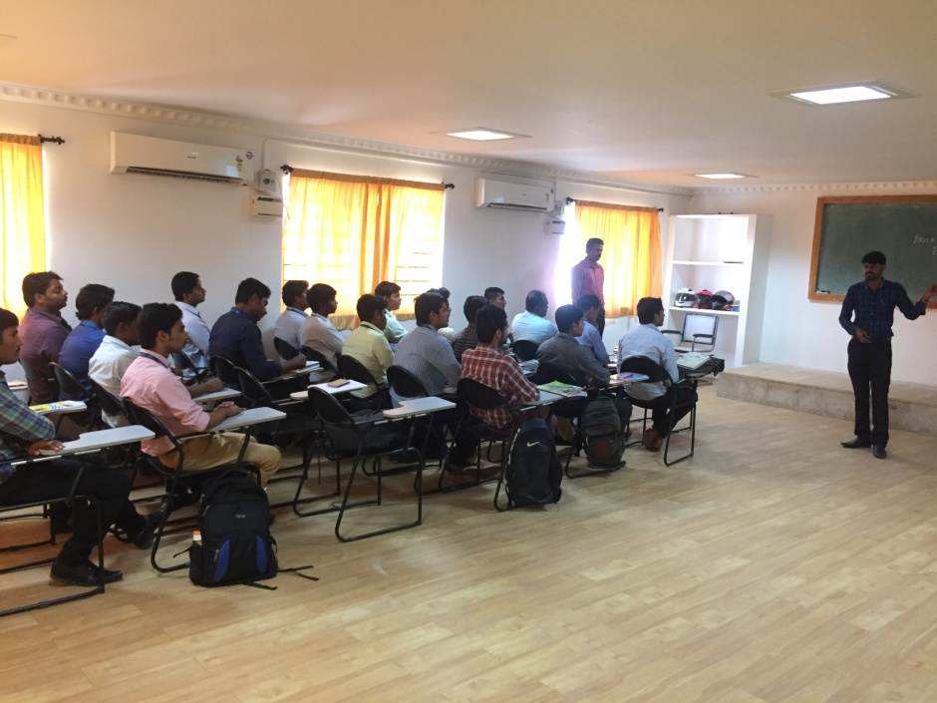
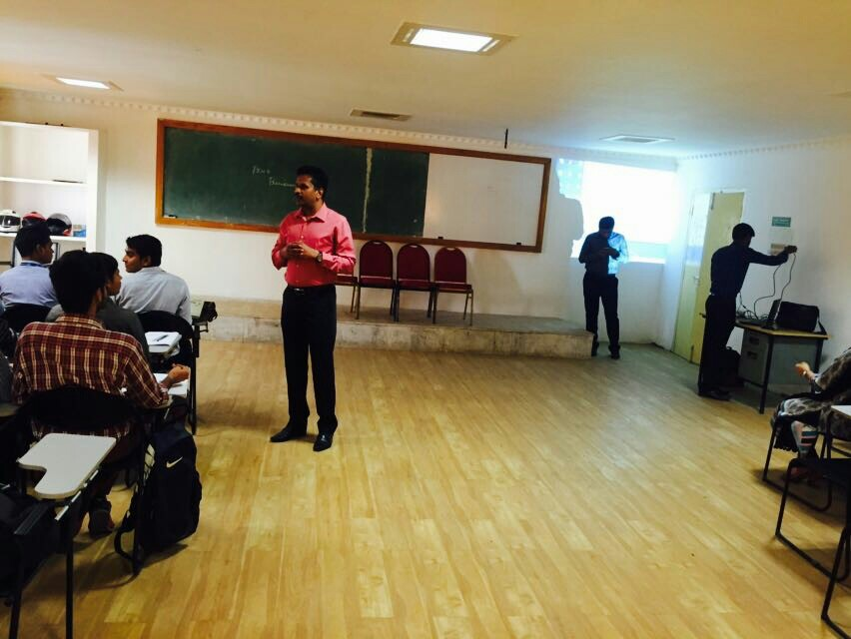
Guest Lecture on Project Management by a Team from Synergy Tech on 21.02.17

Slide 28
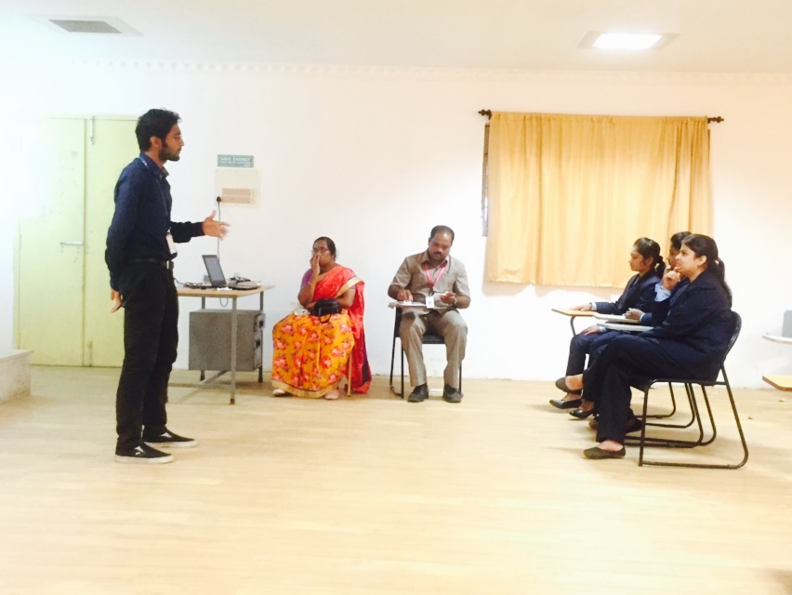
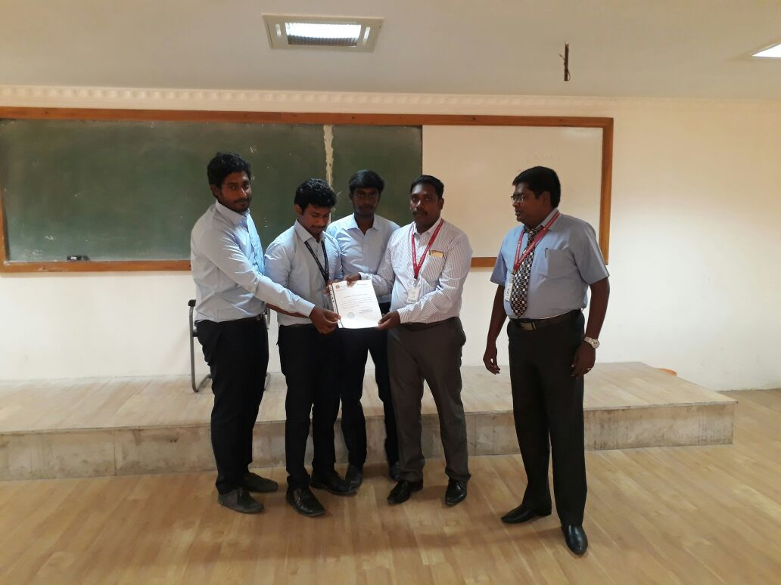
Interdepartmental Competitions 20.03.17

Slide 29
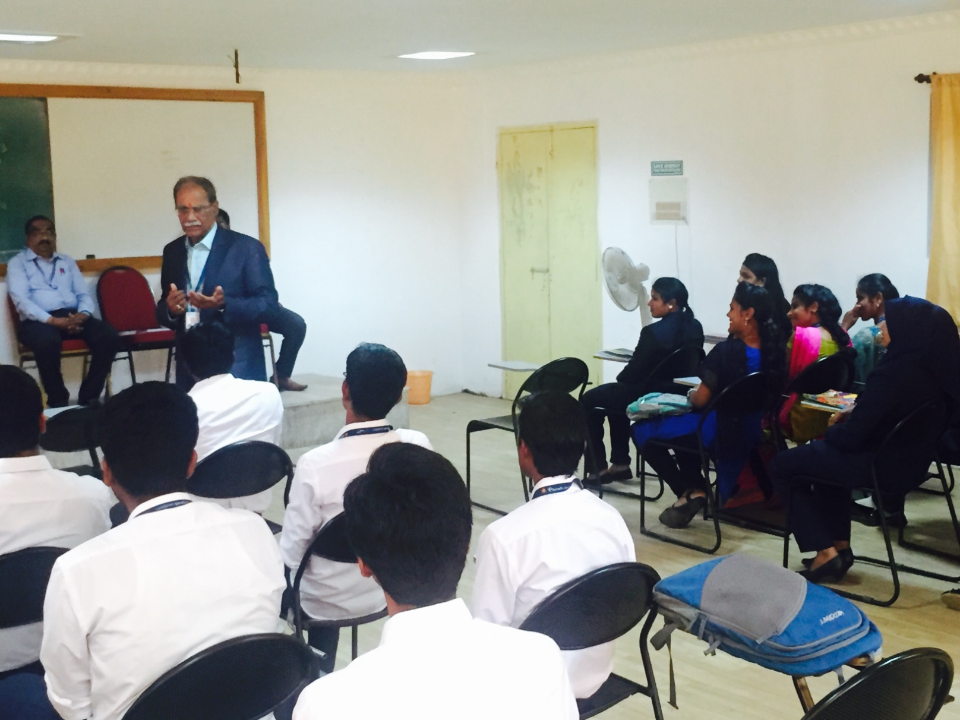
Guest Lecture on Gearing up for Placements by Prof.Gandhi 14.03.17

Slide 30
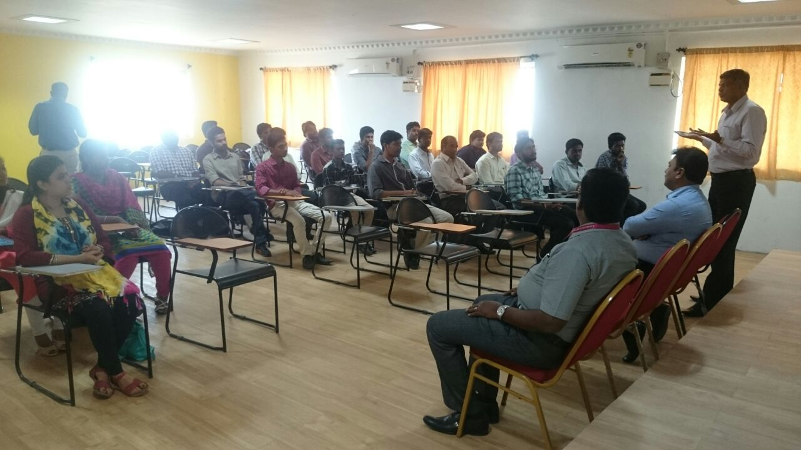
Guest Lecture on Lanscapinng Career by Mr. Krishna Kumar, CEO- Xaxis 17.02.17

Slide 31
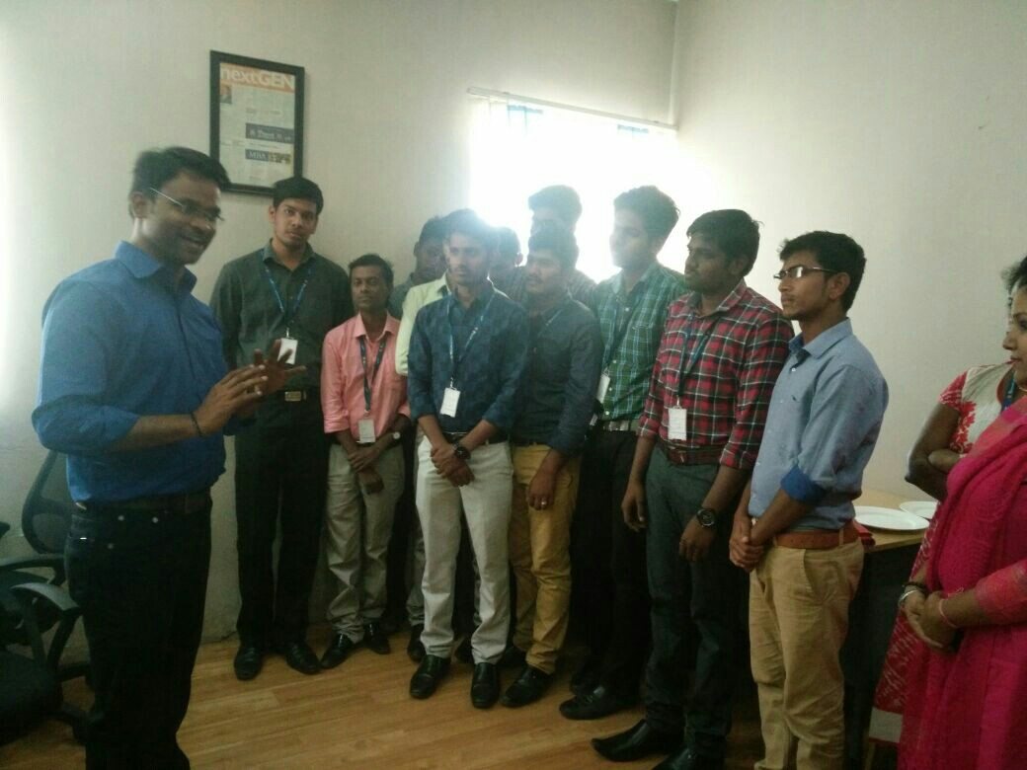
Interaction with Google Community Manager 17.02.17

Slide 32
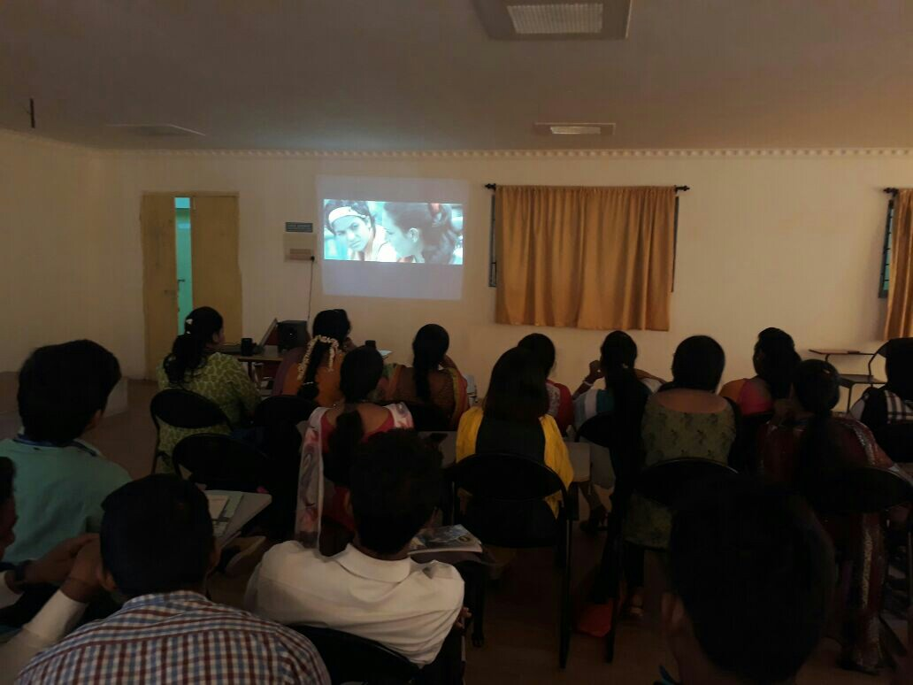
Video Case Study Discussion

Slide 33
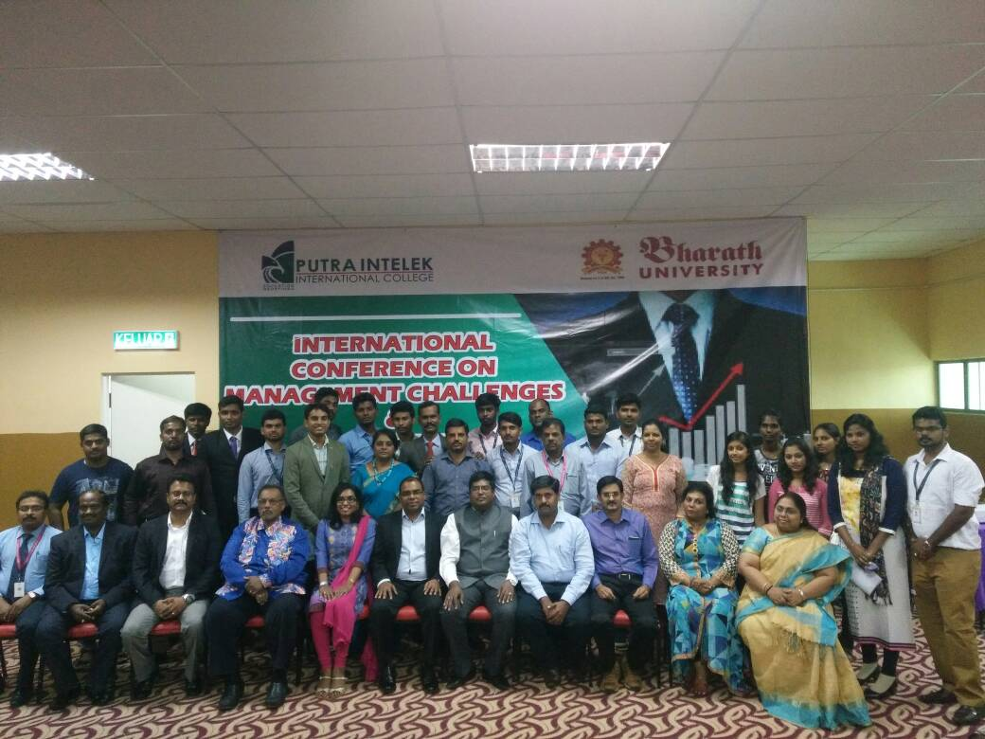
International Conference in Putra Intelek International College, KL, Malaysia – 19-22, July 2017

Slide 34
Dr.S.Praveen Kumar
Director – MBA ,
Bharath University,
Chennai
Mobile: 9840051344

